Slide 1
How to buy a computer
Get What You Need Without Getting Ripped Off

Slide 2
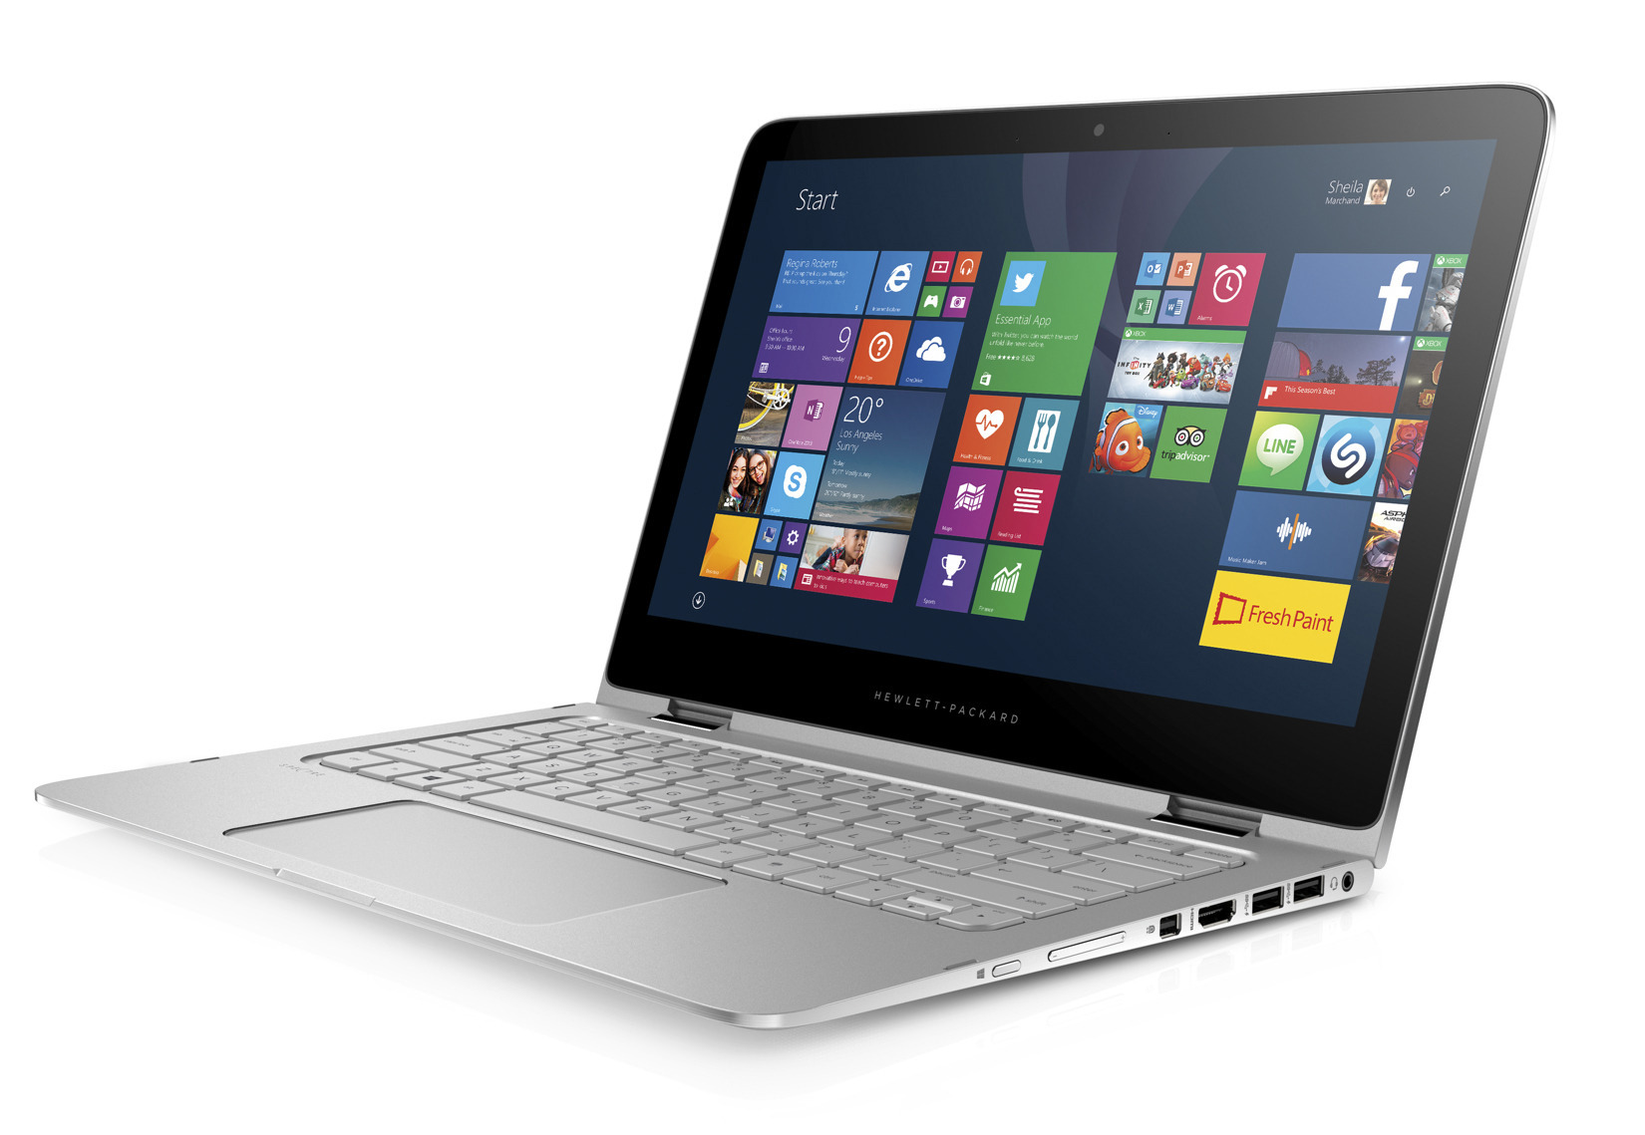
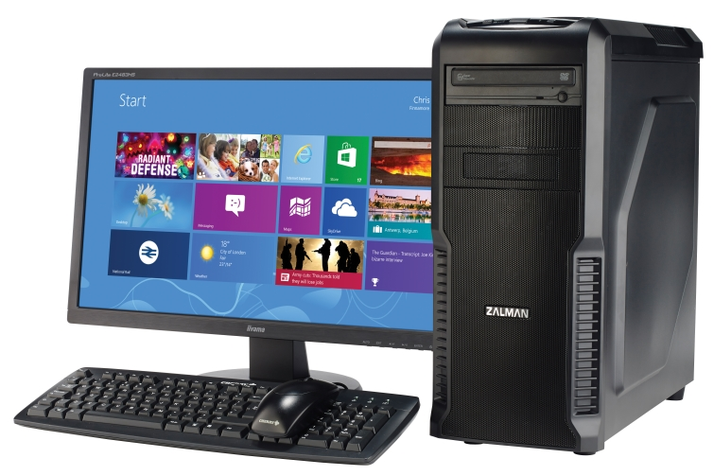
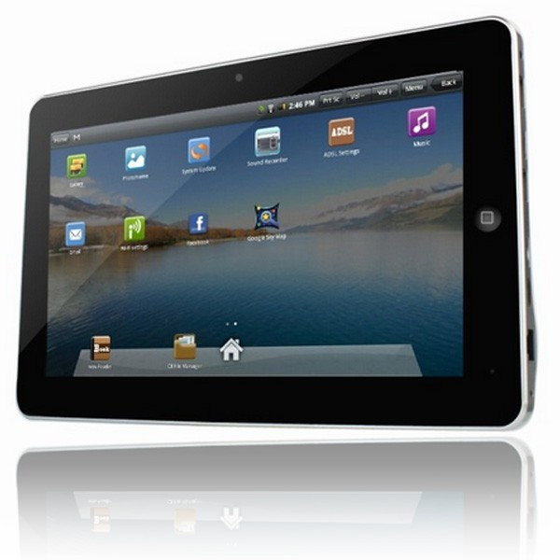
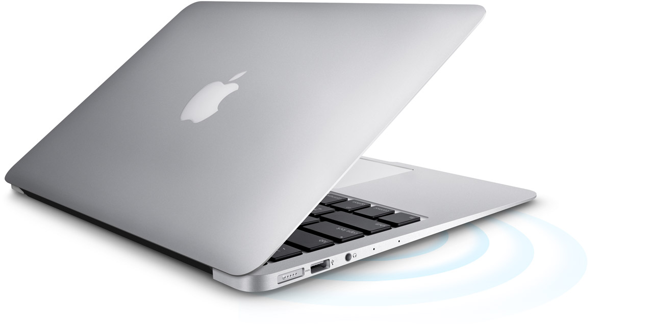
So you're buying a computer

Slide 3
A First Caveat
Computers are Expensive
A computer is an investment
So you should know what you need it to do before you start shopping

Slide 4


What do you need?
Make a list of everything you want to be able to do
Know what you can compromise on
Start doing research!
Notes:
Start simple. Look up Laptop and Google, Amazon, Ebay

Slide 5
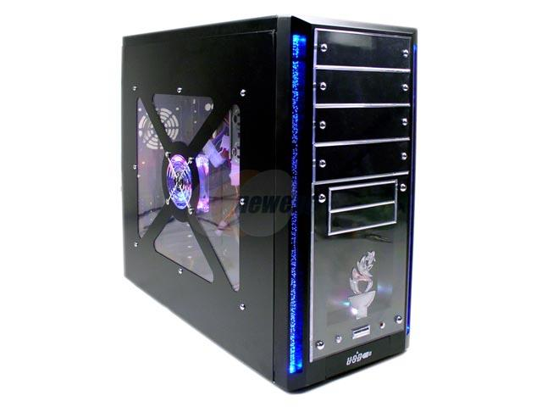
Portable or NOt?
This is probably your first major question
Do you need something that can go anywhere?
Do you need something with a bit more power?
A desktop is stationary, heavy, less expensive, and more powerful
This will influence all of your future decisions when purchasing a computer
Notes:
If you only have one computer, many find a laptop to be the most convenient choice, but they often overlook the massive advantages of a home desktop computer: cost, power, reliability, longevity, upgradability.

Slide 6
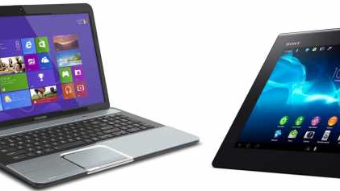
If you decide on portable
Laptop or Tablet?
A laptop is more versatile and powerful while being more expensive and complex
A tablet is intuitive and (sometimes) less expensive, but less versatile, less powerful, and less broadly useful
Notes:
Tablets are cheaper than laptops by far (except flagship tabs). But they are also less useful. They are lighter, easier to lug around, but again, less useful.

Slide 7

Operating System
Windows (Microsoft)
Versatile, inexpensive, more freedom of choice, often frustrating
OS X (Apple)
Intuitive, Powerful, very expensive
Linux (Open Source)
Free, powerful, secure, greater learning-curve
Chrome OS
A mobile operating system designed to be simple and intuitive.
Notes:
Windows is the tried and true. The most popular operating system in the world.
With a Mac, you're getting something that's very expensive,but also very easy to use.

Slide 8
Mobile Operating Systems
iOS
Trendy, Intuitive, Reliable, Locked Down
Android
Powerful, customizable, popular, sometimes glitchy
Notes:
Only Two Options

Slide 9
How to decide?
Some Guidelines:
If you just want to check Facebook, watch YouTube videos, respond to emails and play simple games, a tablet might be all you need
(tablets also have the advantage of a built in camera!)
If you want to do anything more than that, you should consider a laptop or desktop.
From there, your decisions will center around cost, portability, and what operating system you want.

Slide 10
System Specifications
When shopping for a PC, you’ll come across lists of specs.
You should do a little research and learn what some of these things mean.
BUT. There are some basic things to look for.
Notes:
With a tablet or smartphone, system specifications are so closely tied to price, that the phrase"you get what you pay for" is quite literally true. That said, do your research, read reviews, and don't shop impulsively, and you'll be fine.

Slide 11
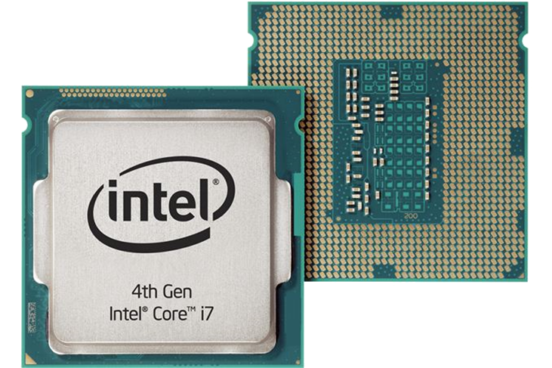
CPU
This is the brain of the computer
Two Main Stats:
Number of Cores
Clock Speed (GHz – Gigahertz)
A Low- to mid-range Laptop should have 2-4 cores and a clock speed of a little over 2 GHz.
A High-end Machine should have 4-16 cores and a speed of 3+ GHz
Notes:
Beware of single-core CPUs

Slide 12
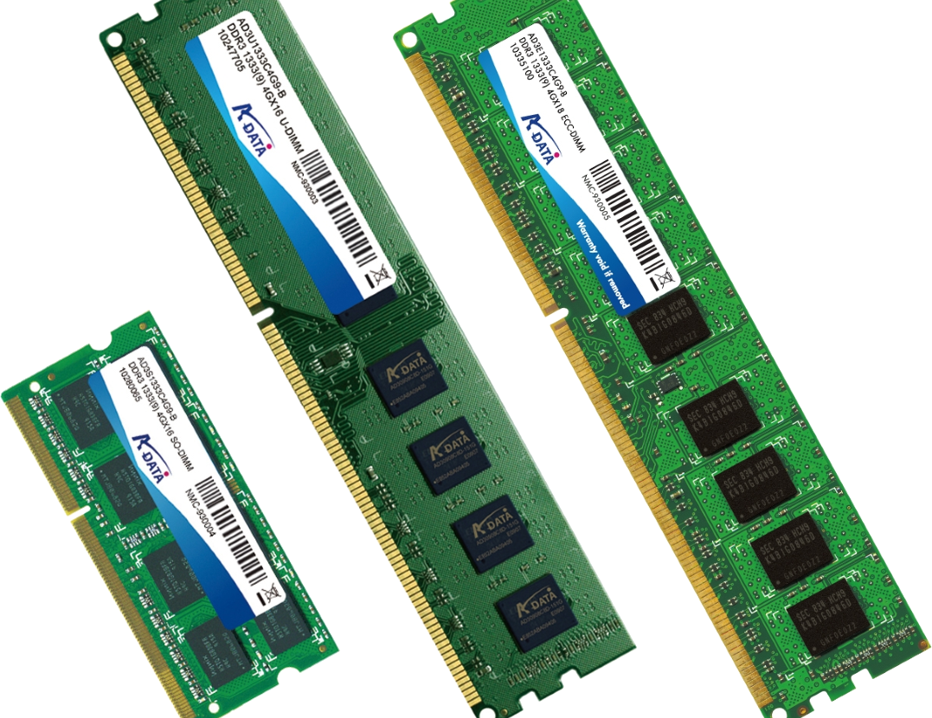
Memory (RAM)
RAM is the memory of a computer.
The more, the better
The bare minimum for a Windows 10 machine is 4 GB. I recommend 8 GB.
A high-end machine should have at least 16 GB.
RAM is cheap, though. You can always upgrade later (even with some laptops).
The type of RAM (DDR3 or DDR4 or whatever) is only really important for the high-end
Notes:
RAM dictates how much your computer is capable of “thinking about” at once. The more the better

Slide 13
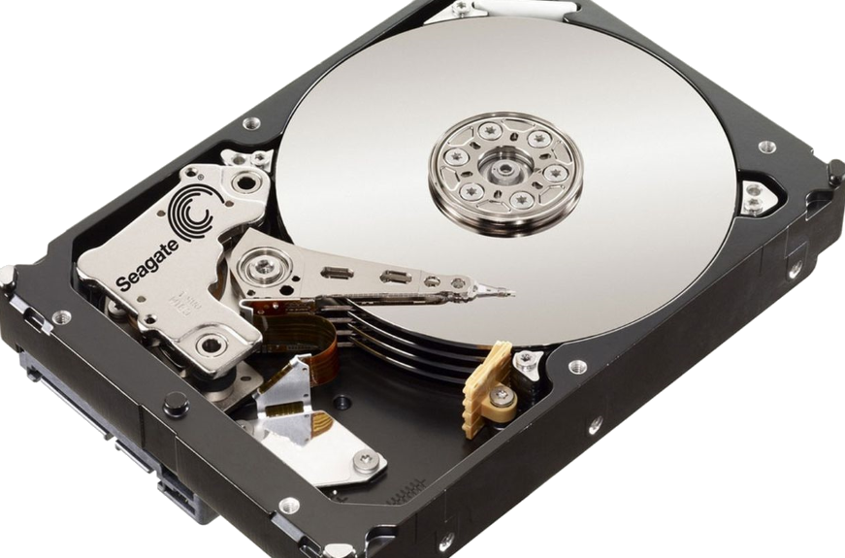
Storage (Hard Drive)
Two types of Hard Drives:
HDD – Traditional Hard Drive
SSD – Solid State Drive
For checking facebook, email, and most productivity work, a 128-256GB SSD will be quick, responsive, and be perfect.
For a mid-range computer, a 256GB SSD plus a 1 TB HDD would be ideal
For a high-end machine, 1 TB at least. Probably 2. And an SSD for the OS
Notes:
HDD – Slower, more storage, less expensive
SSD – WAY WAY faster, less storage, WAY more expensive
Important to remember that SSDs are usually smaller and are not designed to store your family pictures.

Slide 14
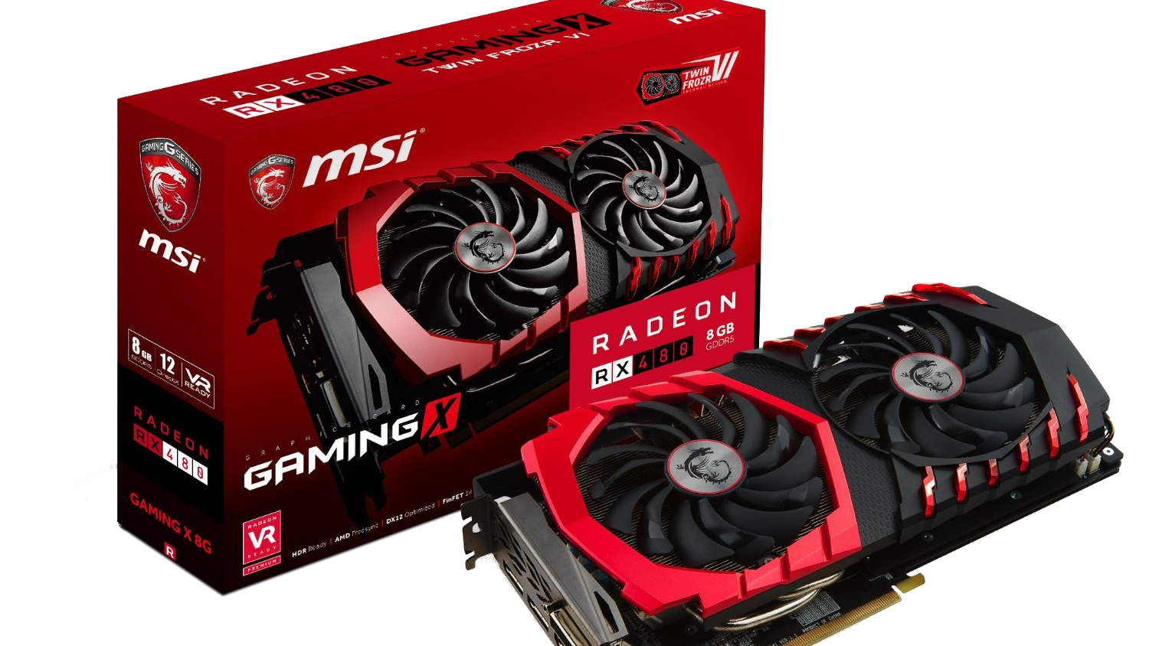
Graphics
Modern computers separate the business logic processing from the graphics processing.
As a result, there is a rather large and competitive “graphics card” manufacturing industry
The typical user, shouldn’t worry too much
The high end user will need to do some homework though. There is a lot to know about graphics cards: GPU chipset, Video-RAM, brand, graphics library compatibility (DirectX and OpenGL).
Note: If you want to do VR stuff, a $200 GTX 1060 is the bare minimum.
Further Note: The prices on GPUs are HIGHLY inflated right now.

Slide 15

Peripherals
Keyboard, Mouse, Webcam, Microphone, Headphones, Wifi, Bluetooth, Speakers, Monitor, Touchscreen, Drawing Tablet, Printer, Scanner, Fingerprint Reader, Joystick, Gamepad, A second Monitor!
Etc……
Get what you need and nothing more
If possible, try before you buy!
Notes:
High-end users should consider high-end equipment or buy cheap and upgrade as you go.

Slide 16
Rules
Do your research
Take your time
Buy when the time is right
Get only what you need

Slide 17
Computer Brands
Trustworthy Brands
Questionable Brands
Apple (with some reservations)
Lenovo (Business Grade Only)
Asus (all around solid)
Dell (Dramatic comeback)
HP
MSI (For gaming)
Microsoft?
Alienware
Gateway
Toshiba (Used to be great, might be again)
Samsung
Acer (on the rise again though)

Slide 18
Where to shop?
Where To Shop?
Where Not To Shop?
Amazon.com
NewEgg.com (Not as good as it used to be)
CDW.com
Manufacturer Direct? (Dell, AlienWare, etc)
Ebay.com
Brick and Mortar: MicroCenter, Fry's
Wal Mart
Target
Other Big Box Stores?
Best Buy?
Office Max?
Notes:
These are all debatable

Slide 19
IF you want to build your own!
It’s not for everyone, but:
It’s not THAT hard.
You’ll “save” money
You get the best value for your dollar
If you want to explore this possibility, come talk to me. I can help.

